Slide 1
Impact of Social Sciences, Humanities and Arts Conference
The Parallel Session on:
Institutional Assessment of Impact for Different Disciplines
13 October, 2021

Slide 2
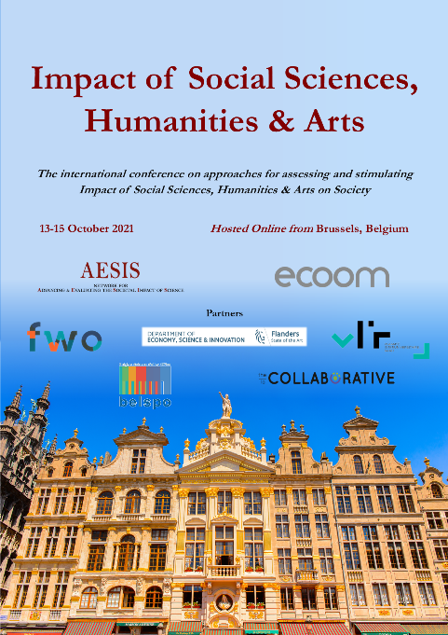
Impact of Social Sciences, Humanities and Arts
13-15 October, 2021
Gunnar Sivertsen (Chair): Research Professor, Nordic Institute for Innovation, Research & Education (NIFU), Norway
Claire Donovan: Professor and Deputy Head of School (Research & Enterprise), University of Greenwich, United Kingdom
Florian Vanlee: Postdoctoral researcher on evaluating artistic research, ECOOM Brussels, Belgium
Overview of the Speakers
#SSHA21

Slide 3
Impact of Social Sciences, Humanities and Arts
13-15 October, 2021
Gunnar Sivertsen
Research Professor, Nordic Institute for Innovation, Research & Education (NIFU), Norway
#SSHA21

Slide 4
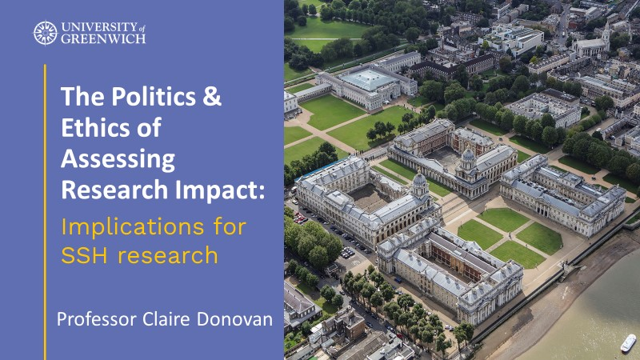
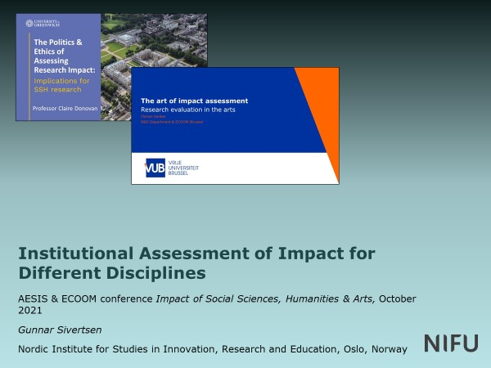
Institutional Assessment of Impact for Different Disciplines
AESIS & ECOOM conference Impact of Social Sciences, Humanities & Arts, October 2021
Gunnar Sivertsen (Chair)
Nordic Institute for Studies in Innovation, Research and Education, Oslo, Norway

Slide 5
Programme for the session on Institutional Assessment of Impact for Different Disciplines
Gunnar Sivertsen: Introduction and framework
Claire Donovan: The Politics & Ethics of Assessing Research Impact: Implications for SSH research
Florian Vanlee: The art of impact assessment: Research evaluation in the arts
Gunnar Sivertsen: Questions for discussion based on our presentations

Slide 6
Our contributions
Background: Societal impact evaluation has been developing for some time:
Widespread now in ex ante assessment of applications for external funding.
Often also part of ex post assessments in organizational evaluations, sometimes linked to funding.
Our task: To introduce a discussion of learned lessons and further challenges from the perspective of the social sciences and humanities

Slide 7
Our contributions
Background: Societal impact evaluation has been developing for some time:
Widespread now in ex ante assessment of applications for external funding.
Often also part of ex post assessments in organizational evaluations, sometimes linked to funding.
Our task: To introduce a discussion of learned lessons and further challenges from the perspective of the social sciences and humanities
Claire Donovan: The rise of the impact agenda in evaluation and funding and the need for an ethical impactology and a bottom-up understanding of societal impact in different fields.

Slide 8
Our contributions
Background: Societal impact evaluation has been developing for some time:
Widespread now in ex ante assessment of applications for external funding.
Often also part of ex post assessments in organizational evaluations, sometimes linked to funding.
Our task: To introduce a discussion of learned lessons and further challenges from the perspective of the social sciences and humanities
Florian Vanlee: How attempts to assess societal impacts in arts & design can remind us that ‘outputs’ are complicated to define, and that impact might not be a good term for understanding the interaction between research and society.

Slide 9
My introduction: Needed for the SSH
A broad understanding and definition of societal interaction
An understanding of how SSH fields of research differ in their forms of societal interactions and the sectors of society that they interact with
An understanding of societal interaction as a daily organizational-level responsibility and activity
I thereby partly respond to the ‘assignment’ of this session:
When can assessment be aligned between disciplines, and
where are the differences in approach, tools or methods needed?

Slide 10
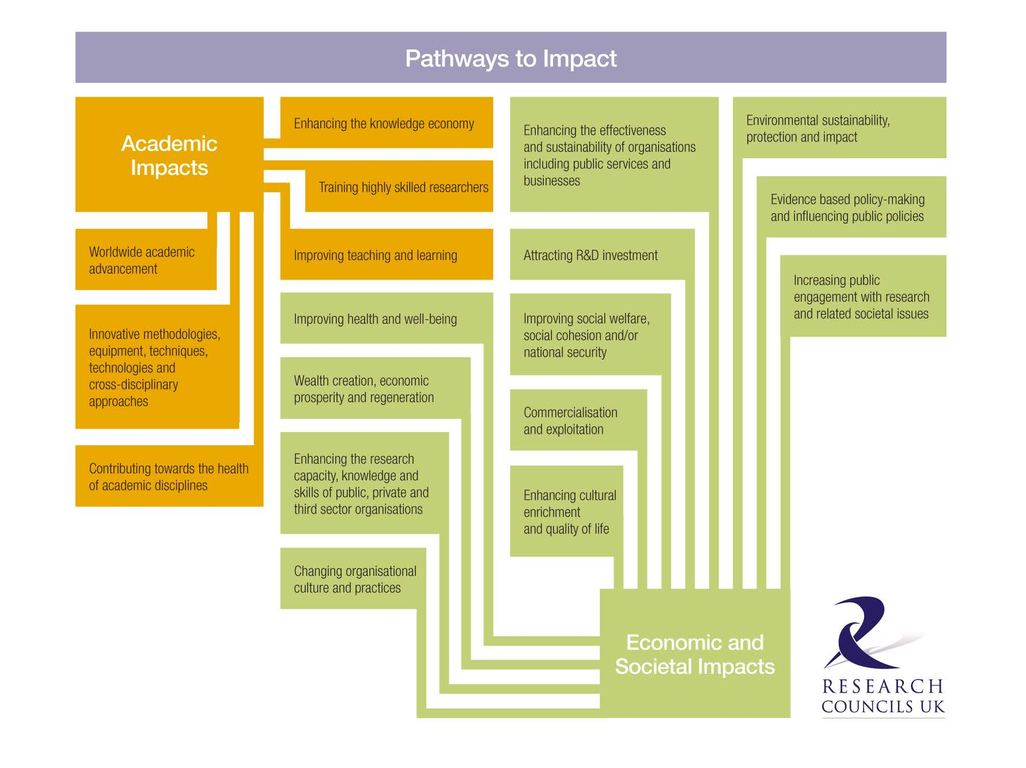
A broad understanding of impact is good for the SSH

Slide 11
A broad definition of impact is good for the SSH
An effect on, change or benefit to the economy, society, culture, public policy or services, health, the environment or quality of life, beyond academia

Slide 12
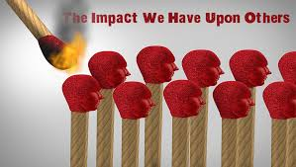
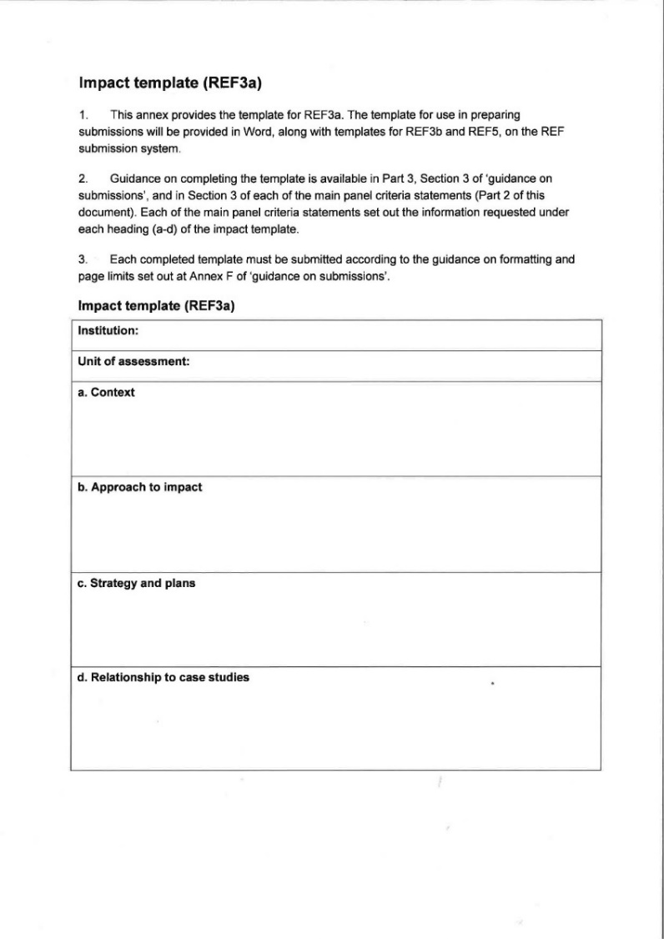
A linear model for understanding societal interaction, and case studies documenting ‘extraordinary’ individual impact, are not good for the SSH
Asking for narratives about:
• The research that underpinned the impact: “This section should outline the key research insights or findings that underpinned the impact, and provide details of what research was undertaken, when, and by whom,”
• The resulting impact: “A clear explanation of the process or means through which the research led to, underpinned or made a contribution to the impact (for example, how it was disseminated, how it came to influence users or beneficiaries, or how it came to be exploited, taken up or applied).”

Slide 13
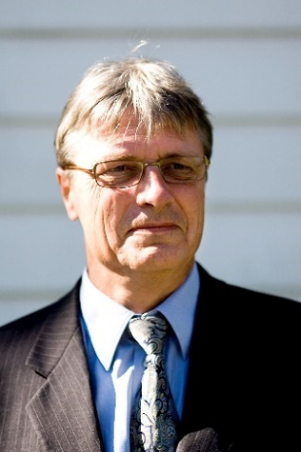
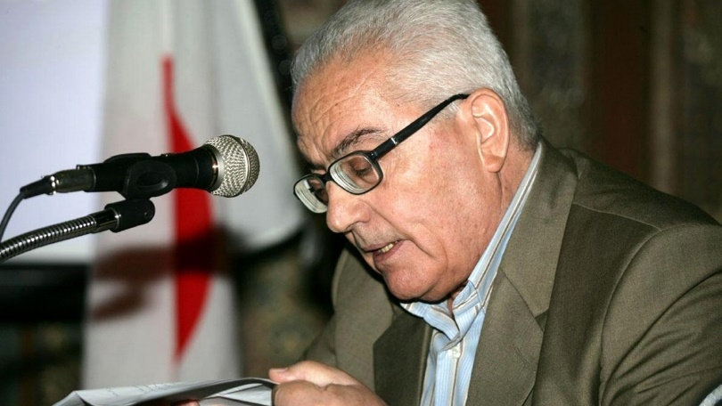
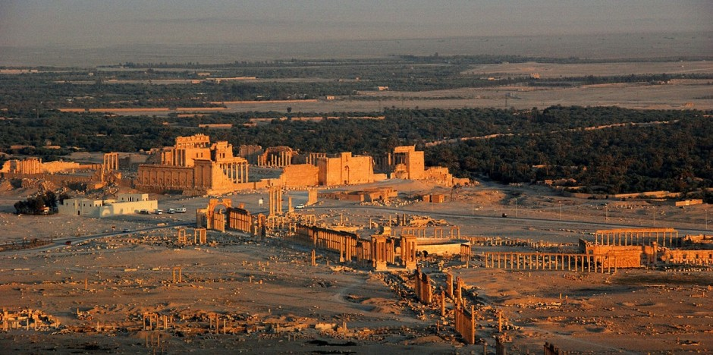
Normal impact in classical archaeology: Palmyra in Syria
Today, investigations of the ancient Mediterranean civilizations are organized as large projects that are agreed with national authorities, funded from several countries, and performed in international collaboration.
One example is the Norwegian-Syrian collaboration on documenting the ancient UNESCO heritage of the archaeological site of Palmyra in Syria.
It started in 2008 and proceeded as a normal international archaeological project …
Jørgen Christian Meyer, professor of archaeology, University of Bergen
Khaled Mohamad al-Asaad, director of Palmyra archaeological site

Slide 14
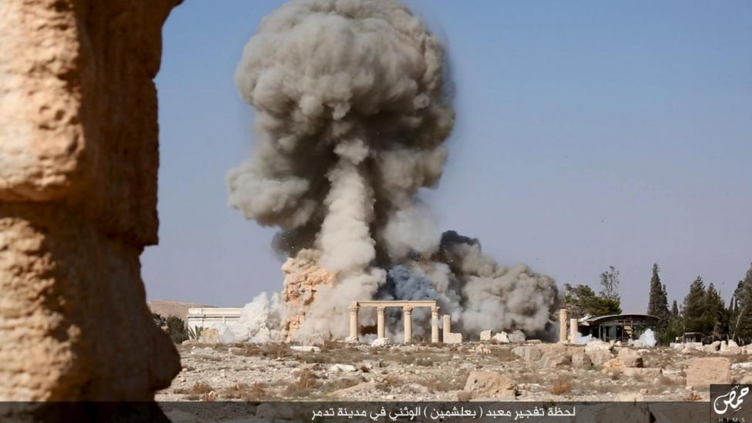
Extraordinary impact: Palmyra in Syria
….until the outbreak of the civil war in 2011.
Then, Palmyra was bombed by ISIS.
The Syrian director of the site was beheaded while the Norwegian experts escaped.
The documentation work done before the destruction now gained immense societal value and international interest.
Jørgen Christian Meyer, professor of archaeology, University of Bergen
Khaled Mohamad al-Asaad, director of Palmyra archaeological site

Slide 15
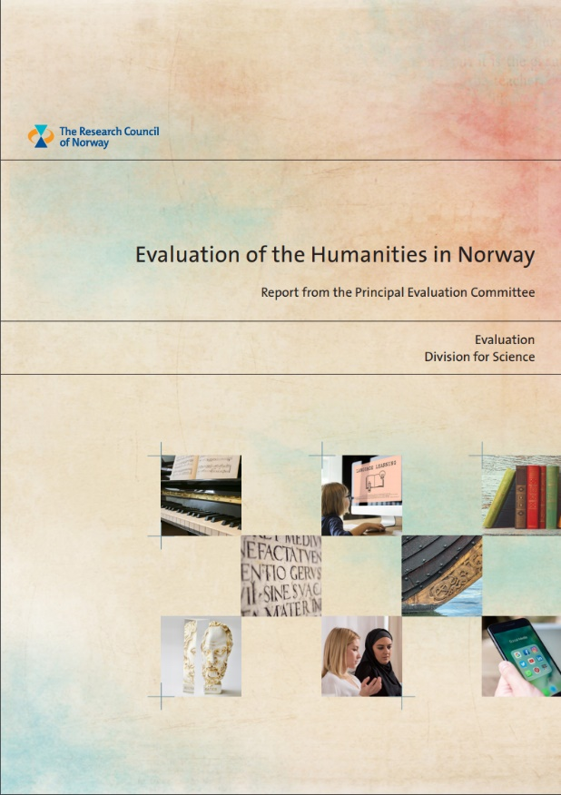
Extraordinary impact: Palmyra in Syria
In 2016, the Norwegian scientists could report the extraordinary impact of their work to the national evaluation of societal impact in the humanities.
Had Palmyra not been destructed, their work would have had the normal societal impact of the humanities and social sciences that is often taken for granted and seldom receives attention.
Jørgen Christian Meyer, professor of archaeology, University of Bergen

Slide 16
Assessment and stimulation of normal societal interaction in the SSH
Each field of research and each research organization has different and typical interactions with society, e.g.
Educational research engages with the school system
Legal research engages with the legal system
Sociological research engages with, e.g., the social welfare system
Historical research engages with institutions and agendas asking for the memory of society
These specific modes of interaction represent more specific organizational-level purposes
Evaluations should relate to such purposes and advise on improvements
Organizations on both sides of the interaction should be allowed to ‘speak’ to the evaluation.

Slide 17
We will now have the two presentations before we return to the discussion

Slide 18
Questions for discussion – a selection based on our presentations
Impact evaluation in the SSH
Representing power and control of knowledge or opening up participation in science?
Making the humanities and social sciences vulnerable or making previously unrewarded research visible?
Encouraging co-production of science with society or silencing politically sensitive participatory research?
Academic freedom vs. directing research; balance of impact vs. blue skies research?
Metrics possible? Risk of simplification and misuse.
The burden of impact documentation and classification
How to document interaction without outputs?
The ‘assignment’ of this session:
When can assessment be aligned between disciplines, and
where are the differences in approach, tools or methods needed?

Slide 19
Impact of Social Sciences, Humanities and Arts
13-15 October, 2021
Claire Donovan
Professor and Deputy Head of School (Research & Enterprise), University of Greenwich, United Kingdom
#SSHA21

Slide 20
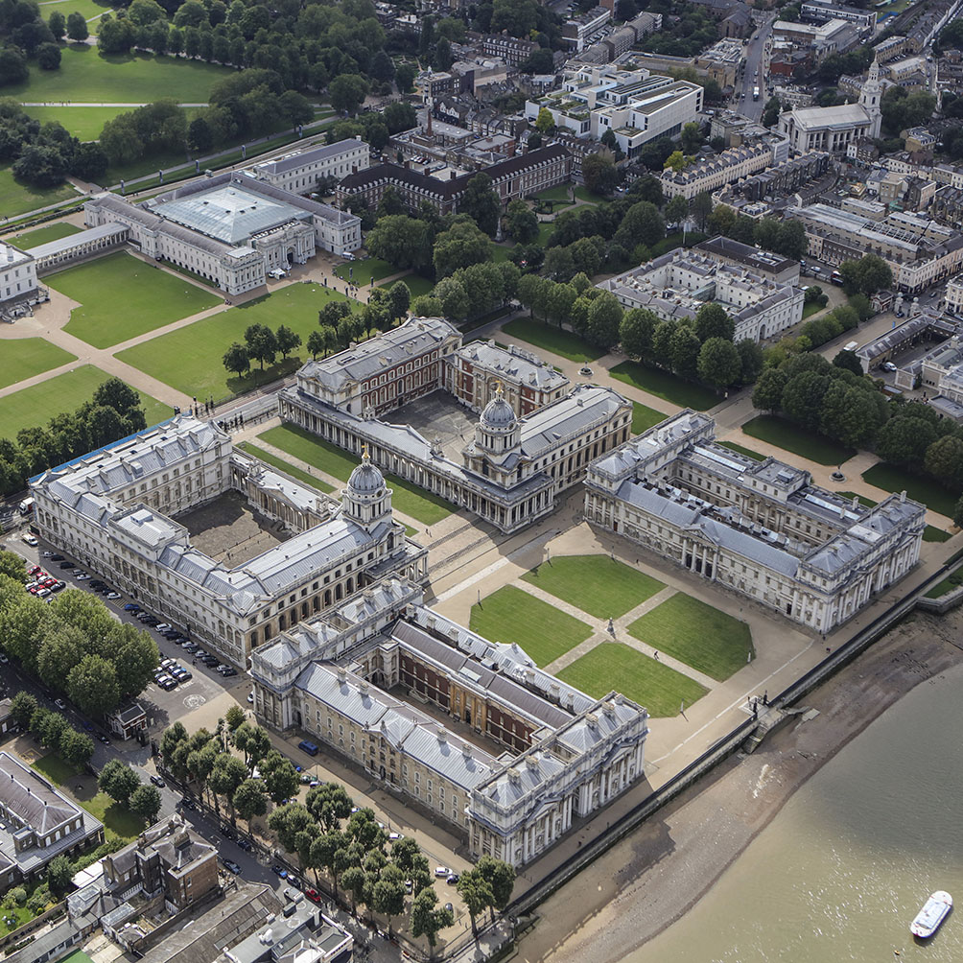
The Politics & Ethics of Assessing Research Impact:
Implications for SSH research
Professor Claire Donovan

Slide 21
Assessing Research Impact
Economic, social, environmental, cultural benefits (broadly defined)
how to define?
how to measure?
political and ethical implications
Growing international interest
e.g. UK REF GBP1.6 billion per year (EUR 1.9 billion) = 25% impact
ex post or ex ante assessment linked to funding

Slide 22
Compact between science and society
Hot topic
Relevance gap
Lack of evidence base
Academic freedom vs. directing research
Balance of impact vs. blue skies research
Effects on science system?

Slide 23
Politics of defining research impact
Spectrum of definitions and measures
narrow vs. widen
simple vs. complex
rewarded vs. invisible
Metrics and measurement are not value free
Bottom-up definitions are wider and more inclusive

Slide 24
Political appropriation of the ‘impact agenda’
Disciplining the academy
power and control of knowledge or opening up participation in science?
humanities and social sciences vulnerable or making previously unrewarded research visible?
encouraging co-production of science with society or e.g. in UK REF2014 was (politically sensitive) participatory research excluded by universities?

Slide 25
European approaches
Ireland, The Netherlands, Norway, UK
range of approaches illustrate power of linking funds to competitive assessment of research impact
linked to distribution of funds and/or institutional rankings & prestige
bottom-up approaches produce more open and inclusive definitions of broader impacts, tend to include qualitative data, are more likely to involve peer review, and reveal a diverse range of impacts
top-down approaches are data-driven, less complex, and have a narrower impact range, usually focusing on scientific impact or economic impact

Slide 26
Committing metricide?
The rise of ‘impactology’
the practice of assessing impacts, and the study of the practice of assessing impacts
‘impactologists’ – management, consultants, software, training
pressures to save time and money
metrics at the expense of more nuance and detail

Slide 27
An ethical impactology
San Fransisco Declaration on Research Assessment (DORA) (2102)
The Metric Tide (Wilsdon et al., 2015)
The Leiden Manifesto (Hicks, et al., 2015)
Responsible use of metrics alongside impact narratives:
transparent
diverse
reflexive
humble

Slide 28
References
Aiello, E., Donovan, C., Duque, E. et al. (2021) ‘Effective Strategies that Enhance the Social Impact of Social Sciences and Humanities Research’, Evidence & Policy, 17(1): 131-146.
Donovan, C. (2019) ‘For Ethical Impactology’, Journal of Responsible Innovation, 6(1): 78-83.
Donovan, C. (2019) ‘Assessing the Broader Impacts of Publicly-funded Research’ in Dagmar, S., Kuhlmann, S. Julia Stamm & Canzler, W. (eds.) Handbook on Science and Public Policy. (Northampton, MA; Cheltenham, UK: Edward Elgar Publishing), pp. 448-502.
Reale, E., Soler M., Donovan, C. et al. (2018) ‘A Review of Literature on Evaluating the Scientific, Social and Political Impact of Social Sciences and Humanities Research’, Research Evaluation, 27(4): 298-308.
Donovan, C., Butler, L., Butt, A. J., Jones, T. H. and Hanney, S. R. (2014) ‘Evaluation of the Impact of National Breast Cancer Foundation-funded Research’, Medical Journal of Australia, 200(4): 214-218.

Slide 29
Thank you

Slide 31
Impact of Social Sciences, Humanities and Arts
13-15 October, 2021
Florian Vanlee
Postdoctoral researcher on evaluating artistic research, ECOOM Brussels, Belgium
#SSHA21

Slide 32
The art of impact assessment
Research evaluation in the arts
Florian Vanlee
R&D Department & ECOOM-Brussel

Slide 33
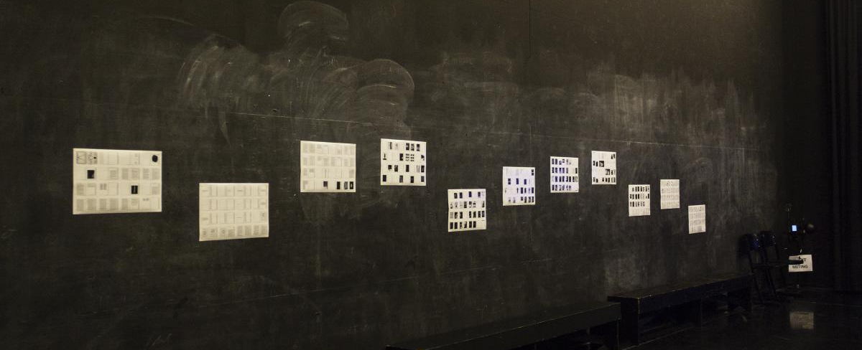
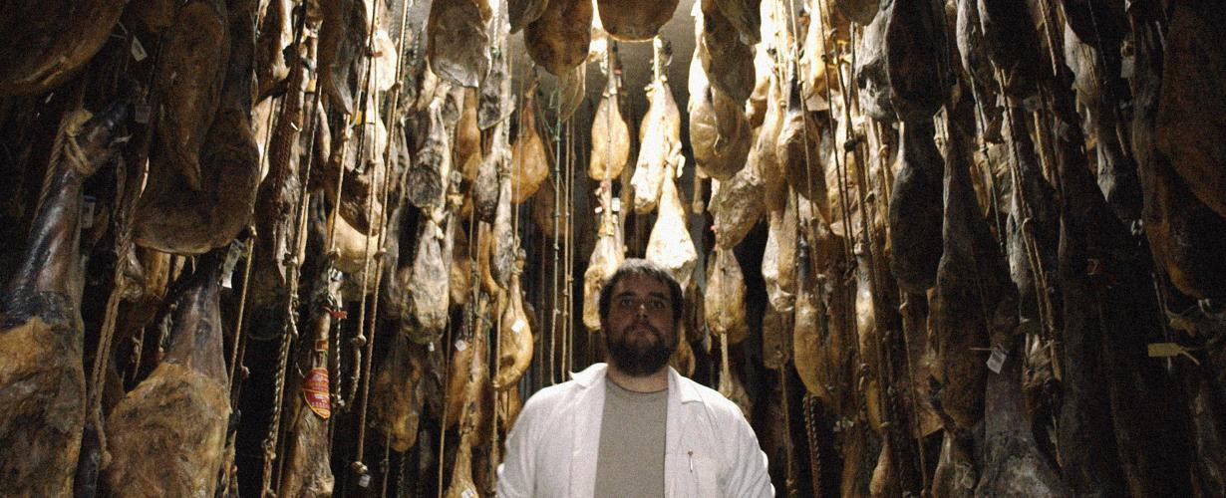
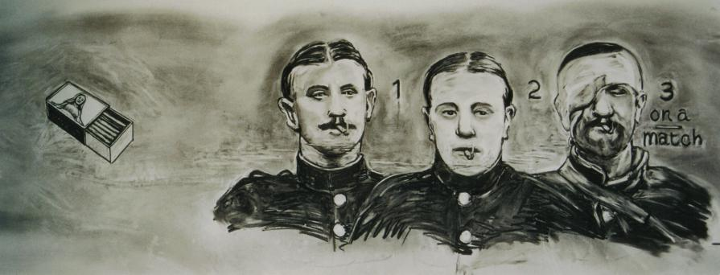
Artistic research
Introduction
Research between the arts and academia
Not research into, but for and with art
By artists
At institutions for higher art education
Resulting in artistic and scholarly outcomes/realizations
‘Discipline’ in development

Slide 34
Artistic research
Introduction
Recent institutionalization in Western Europe
Bologna Process (1999-)
‘Doctorate in the arts’
Academization of higher art education
Mixed reception of developments (cf. artists, academics & national variations)
Tensions between quality regimes

Slide 35
Artistic research in flanders
Introduction
Specific shifts after Bologna
Semi-autonomous Schools of Arts
Between universities & university colleges
Site for artistic research
No mandate to award PhDs (university monopoly)
New challenges for research governance

Slide 36
Artistic research in flanders
Introduction
Organizing artistic research in Flanders
No output monitoring or performance-based assessment
No harmonized output registration
No consensus about appropriate assessment instruments
Governance of artistic research largely decentralised (cf. university associations)

Slide 37
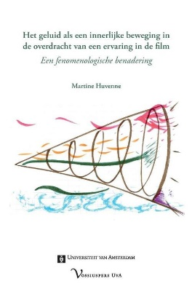
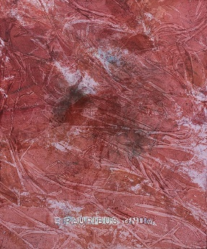
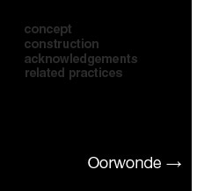
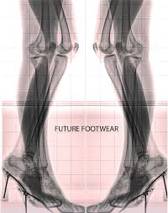
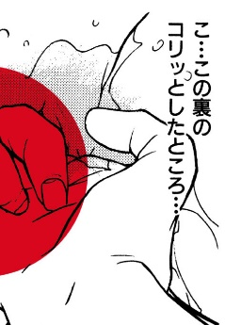
Research impact in the arts
Beyond scholarly judgement
Artistic research troubles ‘traditional’ assessment culture
Academic and/or artistic excellence?
Artistic quality of non-traditional research outcomes?
Academic quality of scholarly output?
How and where does artistic research have impact?

Slide 38
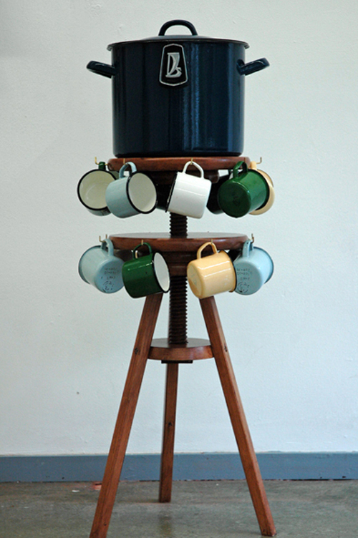
Research impact in the arts
Book chapter (2014)
Beyond scholarly judgement
E.g.: Rosanne Van Klaveren (2010-2018) Towards togetherness: Probing as a decolonizing approach for artistic inquiry. Leuven: LUCA School of Arts.
Website prototype (interactive realization, 2009-2012)
Journal article (2015)
‘Niva to Nenets cooking pot’ (Artefact for exhibition, 2011)
Interactive online documentary (Mixed media realization, n.d.)
‘Ittoqqortoormiit Picnic Blanket’ (Artefact, 2010)

Slide 39
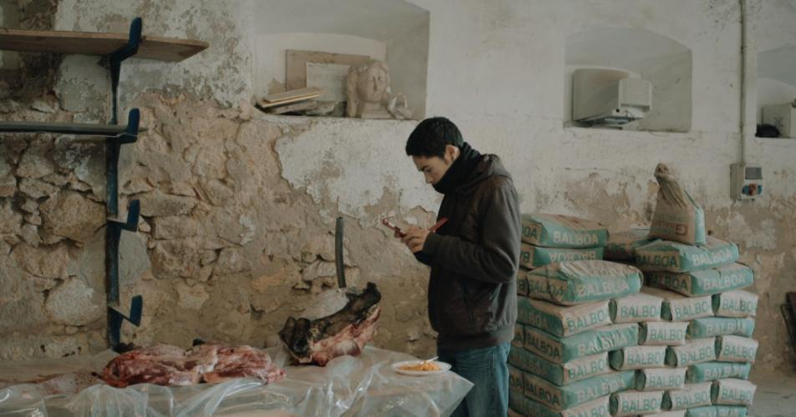
Research impact in the arts
Beyond scholarly judgement
Artistic research defies ‘diachronic’ evaluation
Impact is more than the sum of parts in artistic research
Single realizations have limited meaning
No appropriate indicators to judge quality of outcomes by themselves
Reconciling diachronic & synchronic approaches

Slide 40
Research impact in the arts
Beyond scholarly judgement
The impact of artistic research is manifested on a ‘supra-output level’
Registering outcomes is crucial (// CRIS)
Documenting & disclosing single realisations
Researcher assessment & promotion tracks
‘Citing’ non-traditional outcomes
‘Impact’ indicated by interaction & coherence between outcomes

Slide 41
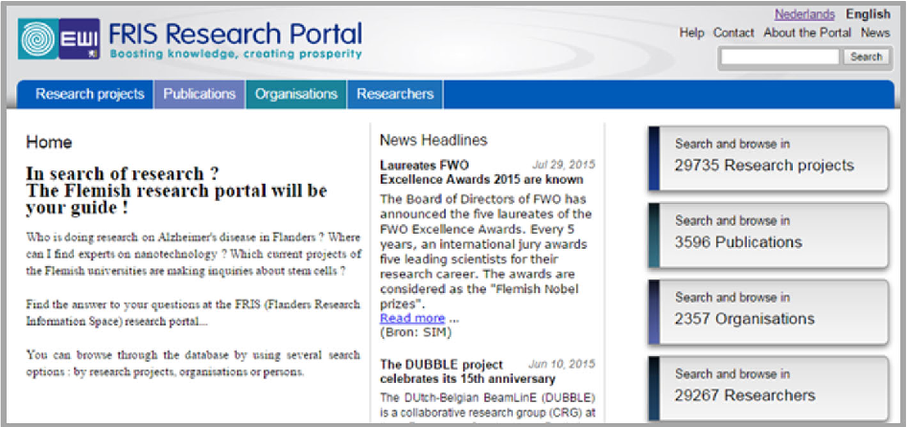
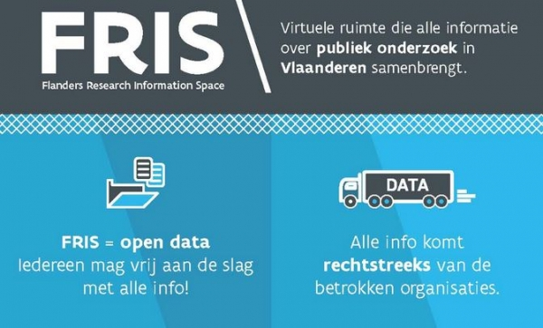
Registering arts & design outcomes
Work in progress
Collaboration (ECOOM-VUB & Schools of Arts) to harmonize CRIS-tools for artistic research outcomes
Registering individual outcomes
Synthesis of existing instruments
Modelled on DataCite metadata standard
‘Exhibiting’ artistic research trajectories on ‘supra-output level’
Exploring ex-post assessment

Slide 42
Registering arts & design outcomes
work in progress
Outcome registration: Individual realizations
Title | Mand. | Text | Enter a title for the realisation
Date (Public dissemination) | Mand. | List | Enter the date for the first public dissemination
Contribution(s) by | Recom. | Text | Enter contributors’ names (if appropriate)
Type of realisation | Mand. | List | Select the proper type of realisation
Description | Recom. | Text | Concisely describe the realisation
Subject | Recom. | List | Select the proper subject (cf. disciplinary codes)
Publisher/Institution/Organization | Recom. | Text | Enter the party involved in disseminating the realisation
Date(s) (Relevant) | Recom. | Text | Enter relevant dates and concisely describe them

Slide 43
Registering arts & design outcomes
work in progress
Research brief: Research trajectories & practices
Title | Mand. | Text | Enter a title for the research brief
Timeframe | Mand. | List | Enter the start (and if appropriate) end date
Collaboration | Recom. | Text | List persons and organisations involved
Research description | Mand. | Text | Enter an abstract or concise description of the research trajectory/practice
Research context | Mand. | Text | Describe the (theoretical/artistic) context of the research trajectory/practice and/or its intended contribution(s)
Recognition | Recom. | List | Document demonstrable instances of recognition (e.g. prizes; reviews; residencies) rewarded over the course of the research trajectory/practice

Slide 44
Registering arts & design outcomes
work in progress
Explicating artistic research trajectories & practices
Research Brief:
AR Explication
Realisation:
Short film
Realisation:
Journal article
Realisation:
Workshop
Realisation:
Documentary
Realisation:
Storyboard
Realisation:
Book chapter
Realisation:
Script

Slide 45
evaluating arts & design outcomes
work in progress
Assessing artistic research performance
Inst. 1
Inst. 2
Inst. 3
Inst. 4
Inst. 5
RB. 1
RB. 1
RB. 1
RB. 1
RB. 1
Selection Expert Panels
RB. 2
RB. 2
RB. 2
RB. 2
RB. 2
Expert evaluation
RB. 3
RB. 3
RB. 3
RB. 3
RB. 3
RB. 4
RB. 4
RB. 4
RB. 4
RB. 4
Selection Institutions
RB. 5
RB. 5
RB. 5
RB. 5
RB. 5
RB. 6
RB. 6
RB. 6
RB. 6
RB. 6

Slide 46
Evaluating arts & design outcomes
The arts and beyond
Approaches address challenges in societal impact assessment
‘Societal impact’ requires synchronic evaluation too
Causal attribution rarely possible
Labour-instensive instruments (e.g. REF; SIAMPI)
Tools risk adding to researcher workload
Instruments must balance detailed information with ease of use
Rich descriptions are crucial
Researchers must conduct research

Slide 47
Evaluating arts & design outcomes
The arts and beyond
Instruments document academic efforts and realizations beyond scholarship
Not exclusively valuable for assessment and evaluation
Documenting how researchers perceive and pursue impact (cf. REF; SIAMPI)
Shaping impact strategies in the future
Appropriate use must be safeguarded
Data not intended for metric assessment should not be operationalized in metric tools
Risk of simplification and misuse (cf. ‘rankings’)
Balancing monitoring and judgement

Slide 49
Impact of Social Sciences, Humanities and Arts
13-15 October, 2021
Thank you!
#SSHA21

